Slide 1



Slide 2

Pet Care App
Supervised by:
Dr. Muhammad Sharif
Group Members:
Aadil Munir ( SP17-BCS-040 )
Ahsan Ayaz ( FA16-BCS-002 )
Presented on December 2020
Department of Computer Science
COMSATS University Islamabad
Attock Campus

Slide 3
Outline
_______________________________
Introduction
Related Work / Applications
Problem statement
Proposed solution
Methodology
Interface
System architecture
Modern tools
Benefits
References
_______________________________

Slide 4

Introduction
Our project is based on android application of a pet care system to provide an easy and comfort platform to user. As we know in this modern and technologically advanced world everyone have smartphone and everyone find a solution using smartphone. And on the other hand everyone have pets in their home, we provide a way to take care of your pet based on mobile application. Having a pet can be a stressful and exhausting experience. So to tackle this situation this application is easier and non-exhausting way to take care of your pet. The pet safety and protection. In this application there is a multiple consoles, one console is for doctor and second console is for user/pet owner.

Slide 5
Continue…
For instance, if they are in a trouble regarding to their pet they should have a way to call, sms to doctor and tell their problem and find a solution. In this scenario Location play an important role as user want to visit at doctor’s place he easily visit using that location.
Same as doctor also find user’s location and visit directly and quickly to user’s place as the problem is serious.

Slide 6
Related work
Name | Weakness | Proposed project solution
11 pets: pet care (App) | Application is develop but not have proper security system. In this app user cannot upload many problems all user upload one by one problem and not given location and doctors feedbacks. | Our application is develop in such way that its provide proper security system. We provide OTP code for security verification. We also set admin approval security system for doctors. We provide location of the doctor so user easily visit.
Carlisle: pet care (Website) | No one given feedbacks, medicines, recommendations, food system only training sessions. | In this app we will provide all features and given all facilities to which user want e.g. best doctors with their location. We provide two way communication so that user easily find solution to their problem.

Slide 7
Continues…
The above cited works show that there is a need of a proper system having all the system having all the features such as calling, sending and receiving messaging, news feed and location through Google map. We proposed this system to have all these features to help people to communicate effectively through a smart phone.

Slide 8
Problem Statement
Applications of smartphones in communication is a major future trend in this advance technology base world. Everyone now a days knows how to use the smartphone and have access of smartphone.
But in this advance world people sometimes face many problems, many application are developed but they did not provide proper security, sometimes they use fake account and did not provide proper information and sometimes location access is given at one side. Sometimes Proper admin approval is not given as well.

Slide 9
Proposed solution
This project is design in a sense to facilitate people. When the user launch this application he has to enter number and password, this is the confirmation that the user is not fake. And user then use the application whatever he want to use features. The system can also make calls, messages, and important is provides location access to user. The main goal is to facilitate people.

Slide 10
Methodology
The table below shows the main specifications we considered in our work:
Language | Java
Technology | Android, Google Map
Tool | Android Studio

Slide 11
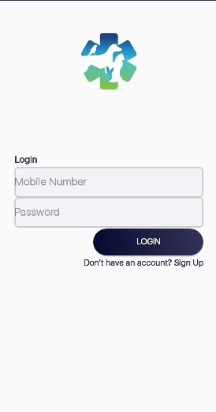
Interface
Home screen
Home screen is the first picture that a user interacts whenever he/she opens or runs an application on his/her android device. User get acknowledgement of application start up. User just enter phone number and password to login into the application as shown in fig.

Slide 12
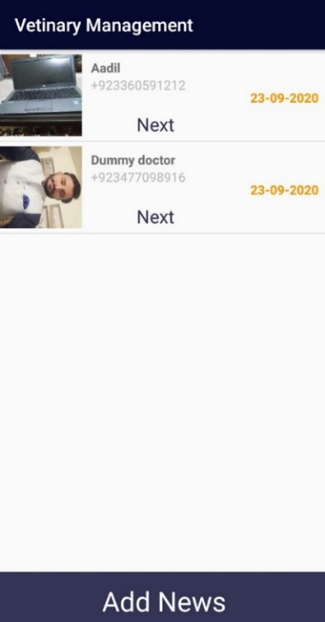
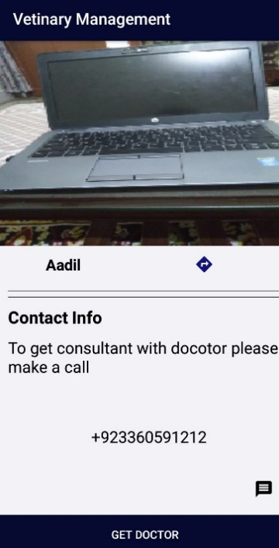
Calling function
To perfume call to someone user need to select the contact from the list , click on the next button then contact detail will open and the number is shown on the screen user need to click on the ‘Get doctor’ button to call.

Slide 13
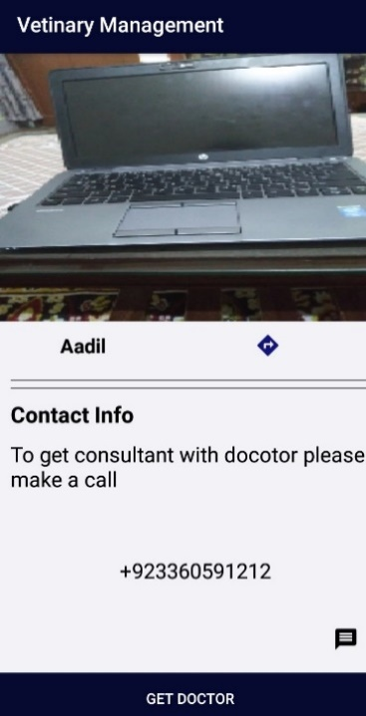
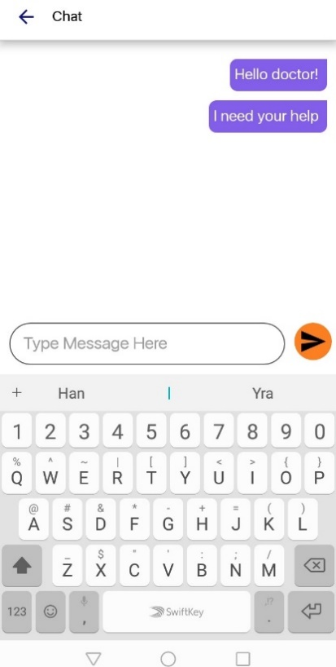
Message function
To perfume two way communication user need to select the contact from the list to which user want to send a text or start a conversation. Just open the contact and then tap on the message ‘icon’ and start conversation.

Slide 14
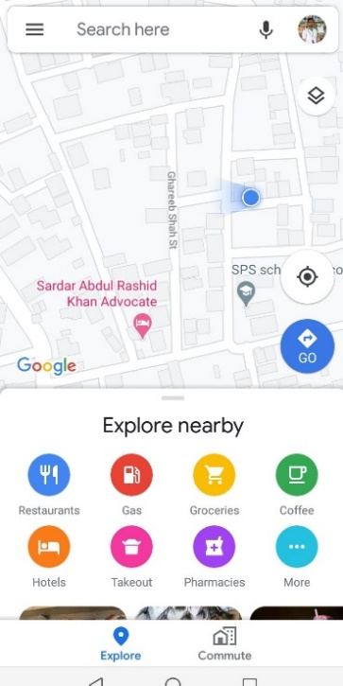
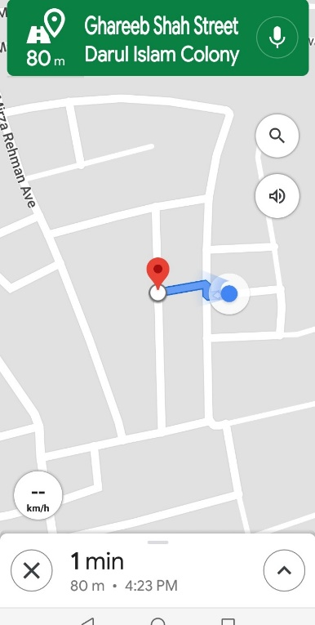
Location access
We also provide location access to user if any user want to visit doctor’s place. User need to select the contact from the list and then open that contact an arrow “ “ is located user just need to tap on that arrow

Slide 15
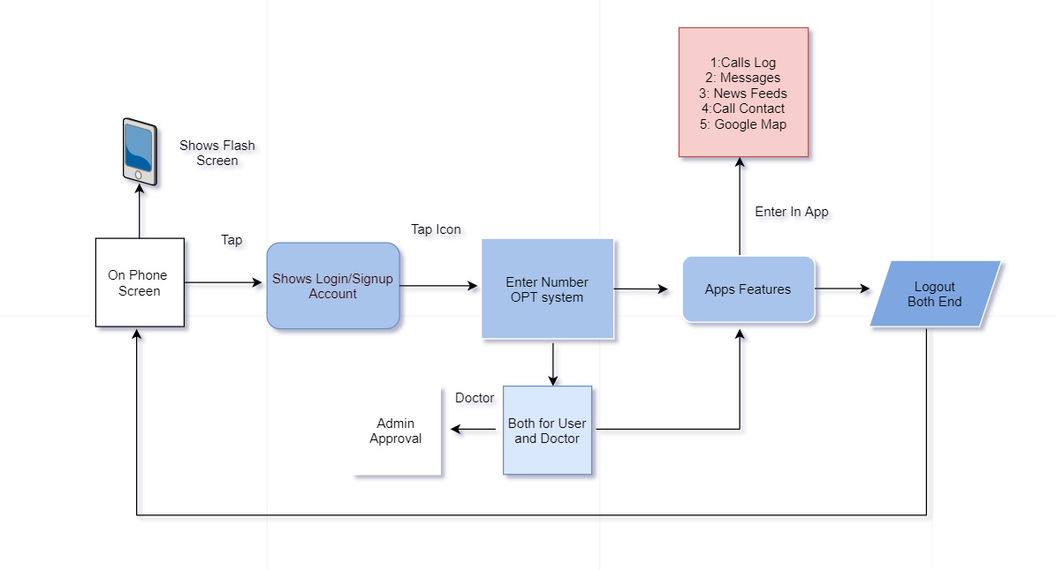
System architecture

Slide 16
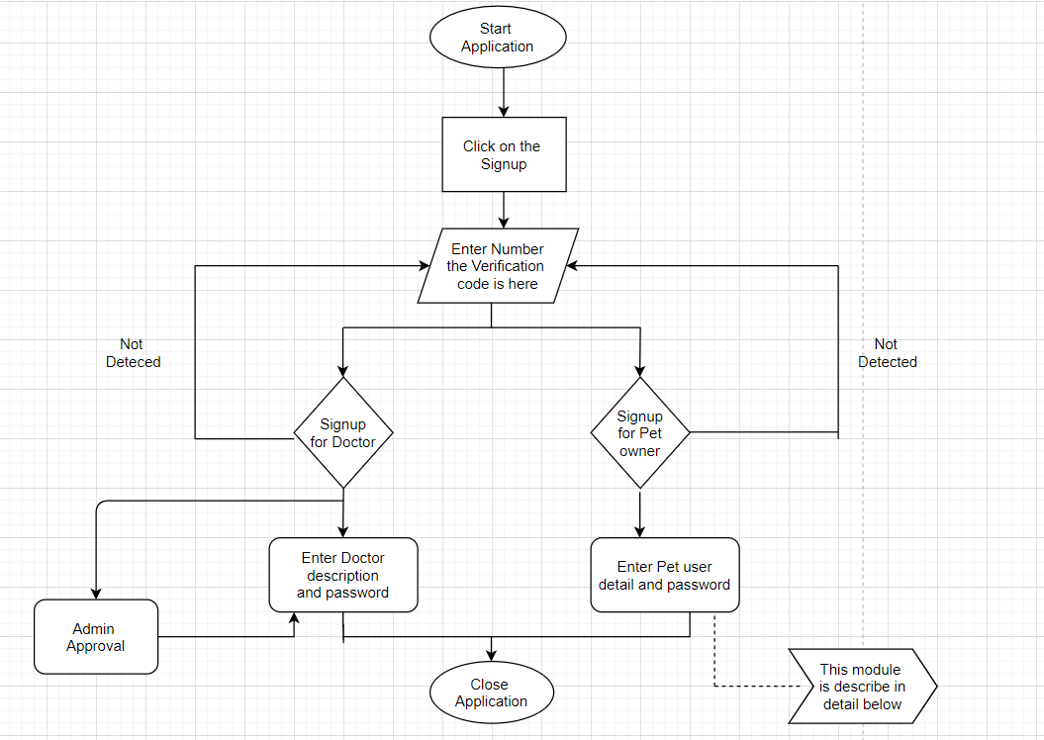
Process Flow Diagram

Slide 17
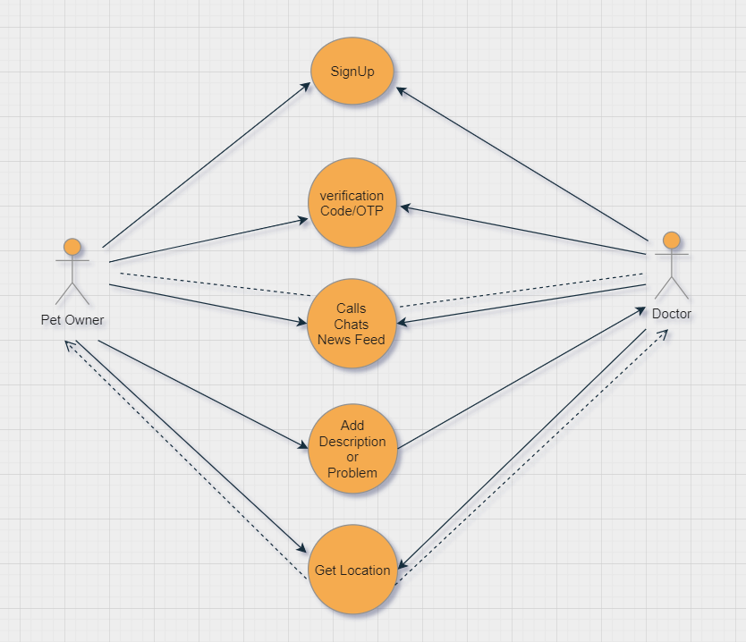
UML Case Diagram

Slide 18
Modern Tools
Software Development kit
Android Studio.
Gradle Plugin

Slide 19
Benefits
User can easily find nearest doctor through this application.
User cannot go physically to doctor if the problem is not serious, he can easily find tips/advice and precaution by the doctor.
Through this application doctor can also visit at user’s place through location access.
User can also concern online medicine from doctor easily.

Slide 20
Continue…..
This application is a great contribution to solve problems of people, by using our technical skills and to learn the mobile application development. We initiated this application with the purpose of making something new, unusual and beneficial to our society.

Slide 21
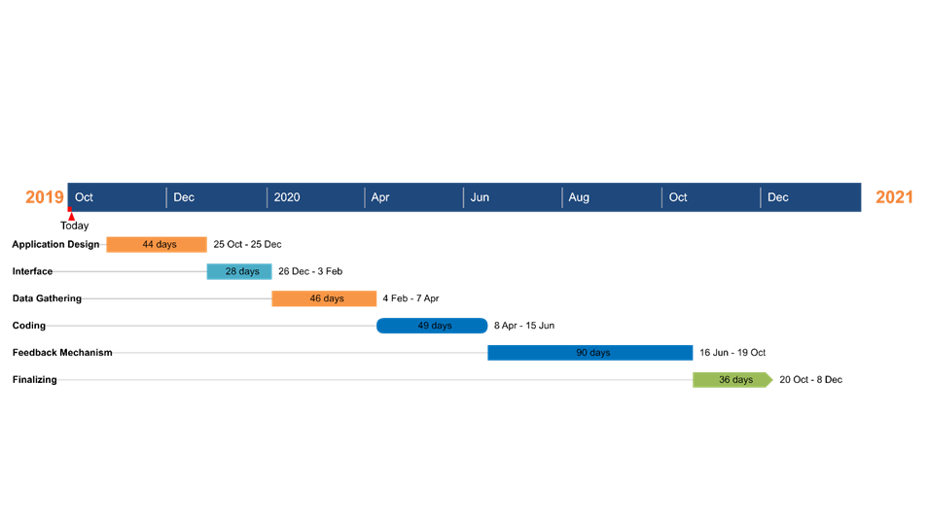
Time line

Slide 22
References
Research paper Link :-
https://www.ijraset.com/fileserve.php?FID=13870
Website Link :-
https://www.lotsoflovepetcare18.com/
App link :-
11pets.elevenpets&hl=en
https://www.academia.edu/37009222/Pet_Care_System_Based_On_Android_Application https://www.researchgate.net/publication/312057960_Stray_Animal_Mobile_App
https://animalcare.folio3.com/pet-care-app-development/

Slide 23


